Slide 1
Generating Scripts in the Style of a TV Show

Slide 2
CSE465- Project Presentation
Members:
01
Md. Rifat Hasan
Faculty – AZK
Mohammad Ashrafuzzaman Khan
1712162642
Section - 3
02
Md. Oahiduzzaman Mondol Zihad
1711855642

Slide 3

Problem Statement:
There needs a lot of product description to be written in production companies.
Also, we sometimes want to write scripts in a specific style.
In this project, we will try to build a Recurrent Neural Network.
The neural network will generate a new ‘fake’ script like a TV show.
It can also be used to generate unique lyrics of songs.

Slide 4
Project Methodology
01
Data Manipulation
Collect required tools and pre-processing data
02
Test Data Loader
Convert data into Tensors and formatted with TensorDataset
03
Build Neural Network
Recurrent Neural Network and LSTM with forward and backpropagation.
04
Train RNN
Use suitable GPU and fine-tune hyperparameters for improved results.
05
Generate Script
Run several times, find appropriate script and compare

Slide 5
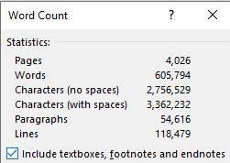
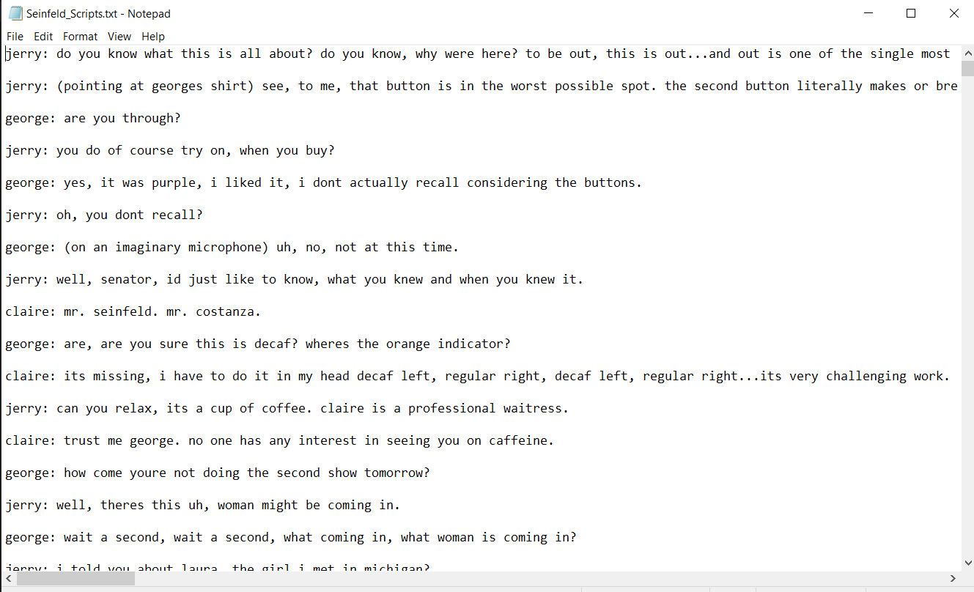
Dataset
We will be using a dataset of “Seinfield” from Kaggle.
It is a popular TV show from 1989-1998. The dataset has scripts from 9 seasons.
A total size of 3.4MB.
https://www.kaggle.com/thec03u5/seinfeld-chronicles?fbclid=IwAR2iwIXjyY21B5ABhQLB10YjAG_nKl0NRX1QnZH9AO2Am_ttPkfwpm5fN6c

Slide 6
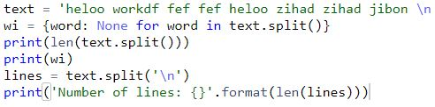
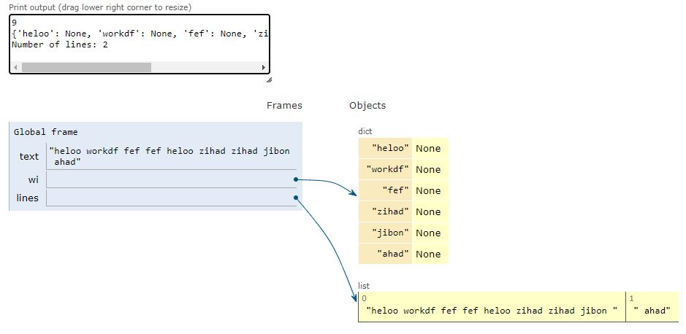
Embedding Data

Slide 7
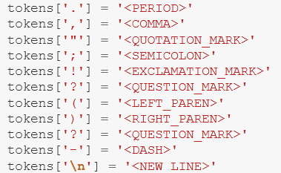
Pre-process Data
Pre-Processing Function
Lookup Table
Tokenization
Dictionary to go from the words to an id
Dictionary to go from the id to word

Slide 8

GPU Availability
Cuda Toolkit 10.2
train_on_gpu = torch.cuda.is_available()
print(train_on_gpu)

Slide 9
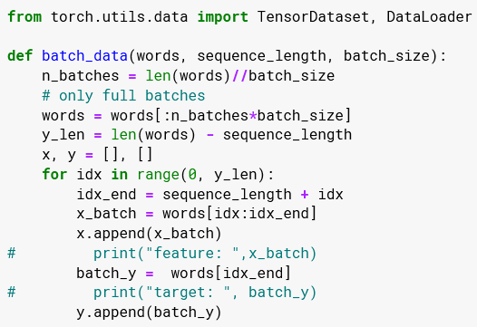
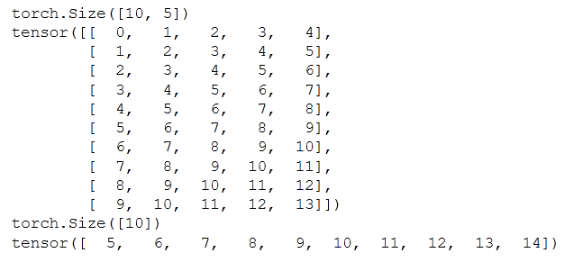
Batching
We implement the “batch_data” function to batch “words” data into chunks of size “batch_size” using the “TensorDataset” and “DataLoader” classes. For example, say we have these as input:
words = [1, 2, 3, 4, 5, 6, 7]
sequence length = 4
Our first feature_tensor will contain this values
[1, 2, 3, 4]
And the corresponding target sensor will just be the next “word” or tokenized word value:
5
This will continue with the second feature tensor and target_tensor
[2, 3, 4, 5] #feature_tensor
6 #target_sensor
.

Slide 10
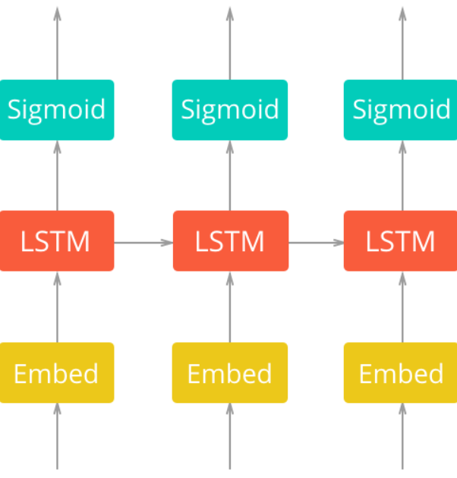
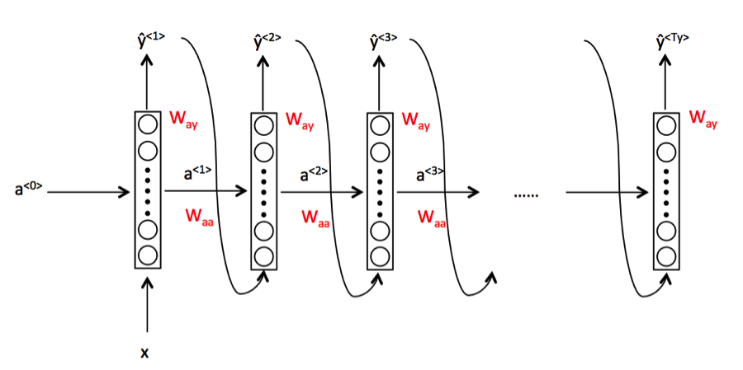
Network Architecture

Slide 11
Hyperparameters:
sequence_length for the length of a sequence
batch_size for the batch size
num_epochs for the number of epochs to train for
learning_rate for the learning rate for Adam optimizer
vocab_size for the number of unique tokens in our vocabulary
output_size for the desired size of the output
embedding_dim for the embedding dimension, smaller than the vocab_size
hidden_dim for the hidden dimension of RNN
n_layers for the number of layers/cells in RNN
show_every_n_batches for the number of batches at which the neural network should print progress

Slide 12
Other Parameters
Function for output probability Softmax
Loss Function Cross Entropy Loss
Optimizer Adam Optimizer
Regularization Dropout

Slide 13
First Approach
Train-1
sequence_length = 10,
batch_size = 64,
learning_rate = 0.003,
embedding_dim = 300,
hidden_dim = 250,
n_layers = 2
Started with Loss: 9.202159190654754 and at epoch 4 it was Loss: 9.206429640371343
sequence_length = 10,
batch_size = 64,
learning_rate = 0.01,
embedding_dim = 200,
hidden_dim = 200,
n_layers = 2.
Started with loss: 9.25 and after 4 epochs the loss was still around 9.26.
sequence_length = 20,
batch_size = 20,
learning_rate = 0.3,
embedding_dim = 300,
hidden_dim = 250,
n_layers = 2
Started with Loss: 9.70091618013382, and at epoch 4 it was still around 9.6
Train-3
Train-2

Slide 14
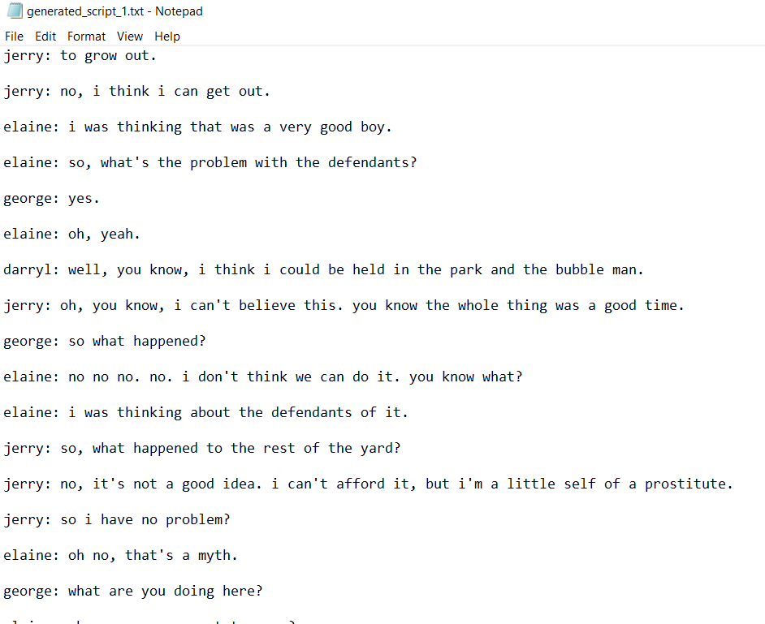
Result 01
After first approach, we
realized we have some
issues in our result
related to zero_grad, extra dropout layer and sigmoid layer. Fixed issues and
retried.

Slide 15
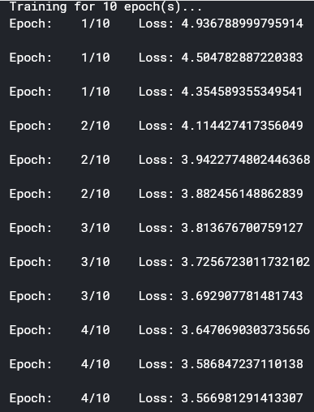
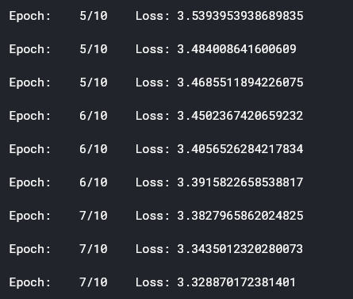
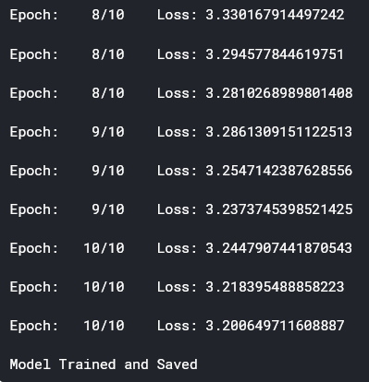
Second Approach
sequence_length = 10, batch_size = 128, learning_rate = 0.001,
embedding_dim = 200, hidden_dim = 250, n_layers = 2.

Slide 16
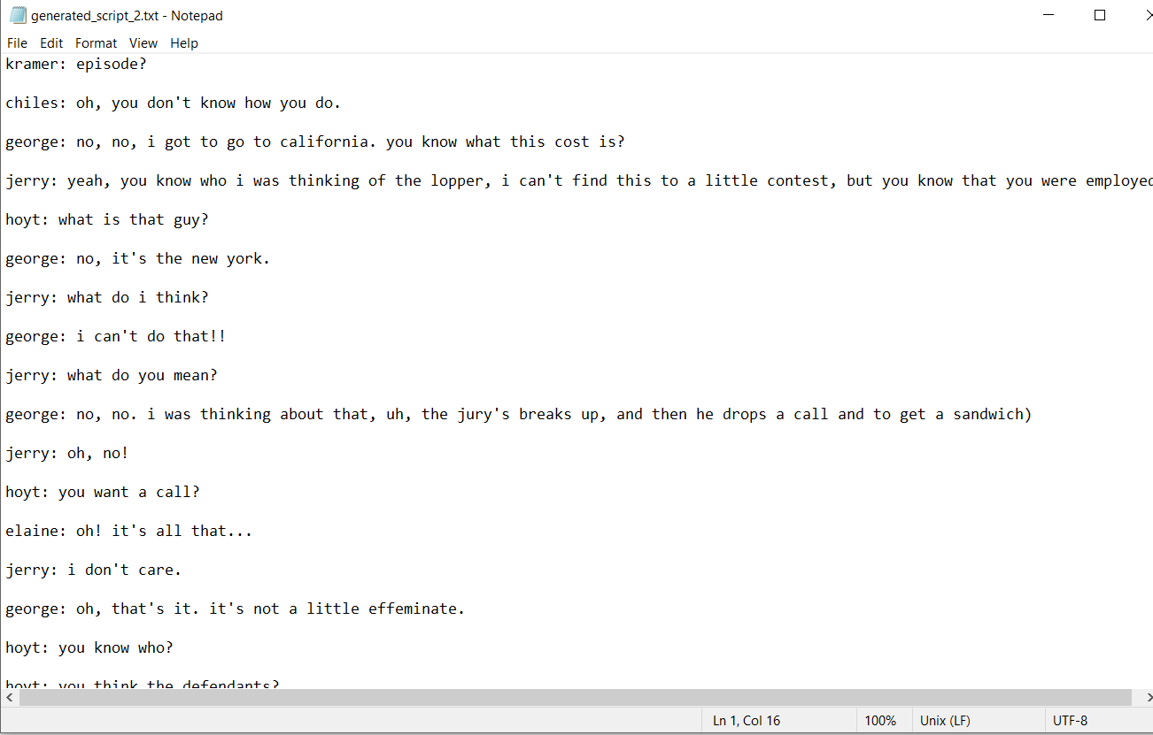
Result 02
Here is the output of our
generated script of
second approach.

Slide 17
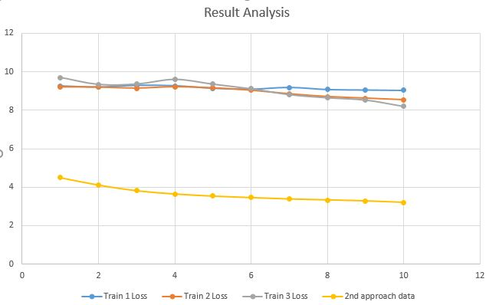
Result Analysis
Loss
Epoch

Slide 18
Learning Outcomes
Manipulation of data.
Process like Batching and word2vec embedding.
RNN layers and their improvements.
Use of GPU.
Effects of hyperparameters, optimizers and regularization.
Solution for problems like vanishing gradients, exploding
gradient etc.

Slide 19
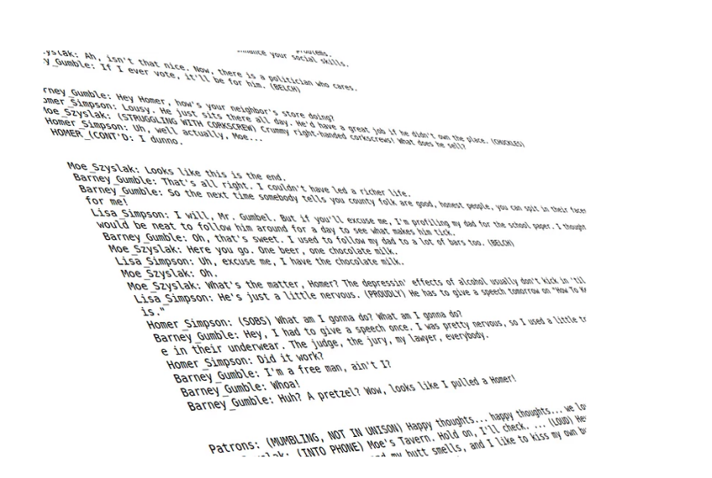
Conclusion
The generated script may not always make perfect sense.
It will look like alternating lines of
dialogue.
In our results, we get multiple
characters to say complete sentence.
To get a good results, it will take more time to train and smaller vocabulary discarding uncommon words.
Using more data can also be a way to improve results.

Slide 20
GitHub Link
https://github.com/OahidZihad/CSE465-TV-Script-Generator

Slide 21
Thank You

